Slide 1


Human Resources Dataset Analysis
Project team:
1- Ahmed AbdelGawad
2- Abdelrahman Ghorab
3- Abdelrahman Masoud
Instructor Dr.Amal Mahmoud

Slide 2

Table of Content
01
05
Objective
EDA
02
Introduction
06
Recommendations
03
Challenges
07
04
Questions
Methedology

Slide 3

Objectives
Analyze HR data to identify trends that contribute to employee retention and satisfaction, providing actionable insights to improve employee engagement.
Utilize HR data to recommend informed decisions on promotions and salary adjustments, ensuring equitable outcomes for all employees.
Leverage HR insights to assess and improve workplace fairness and productivity, supporting the development of better policies and practices
Conduct workforce analysis to guide strategic decisions, ensuring the right talent is in place to meet future business growth and role requirements
Monitor HR trends and insights to help the organization stay competitive and adaptable as it evolves, providing data-driven support for ongoing success

Slide 4
Introduction
HR today is about more than just hiring and payroll—it's a key part of shaping company success. From keeping employees happy to building strong teams and planning for the future, HR plays a big role.
Understanding HR data helps companies:
Keep good employees and boost satisfaction
Make smart choices about promotions and salaries
Create a fair and productive work environment
Plan for future growth with the right people in the right roles
As businesses grow and change, using HR insights is essential to stay competitive and successful

Slide 5

Challenges
Data Quality & Accuracy Incomplete, outdated, or inconsistent employee records can lead to poor decisions.
Lack of Standardization Inconsistent formats or definitions (e.g., job titles, departments) make it hard to compare or combine data.
Change Resistance Teams may be hesitant to rely on data over intuition, especially in people-centered roles.

Slide 6

Methodology

Slide 7

Methods
1
Understanding the Data
2
Data Cleaning (Using Power Query & Other Methods
3
Identifying Outliers & Data Distribution
4
Capping Outliers to Normal Ranges
5
Data Consolidation & Modeling
6
Producing Insights using DAX and visulization using Excel

Slide 8


Overview
This dataset provides structured insights into various aspects of an organization’s workforce, including:
Employee Performance – Tracks performance evaluations and reviews.
Satisfaction Levels – Links employee satisfaction to workplace factors.
Education & Qualifications – Captures educational background and its impact.
Salary Distribution – Provides salary ranges for different job roles.

Slide 9
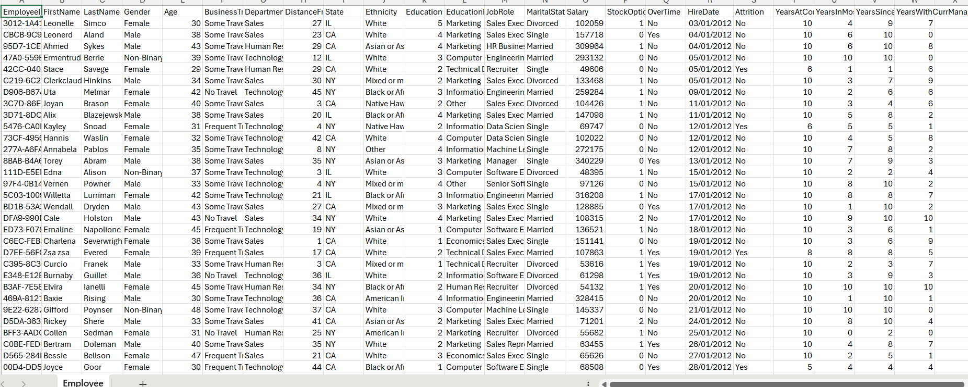
Data OverView

Slide 10
Employee Data
Employee ID
FirstName
LastName
Gender
Age
Business Travel
Department
Distance From Home (KM)
State
Ethnicity
Education
Education Field
Job Role
Marital Status
Salary
Stock Option Level
Over Time
Hire Date
Attrition
Years At Company
Years In Most Recent Role
Year Since Last Promotion
Years With Curr Manager
Rows: 1471 rows

Slide 11
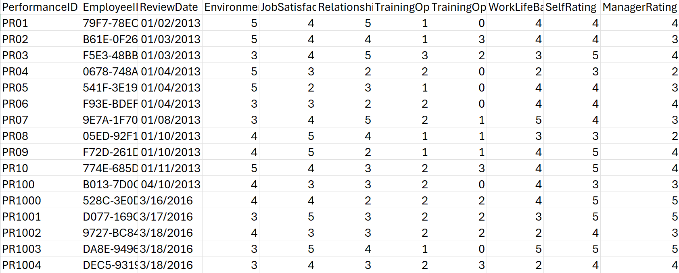
Data OverView

Slide 12
Performance
Performance ID
Employee ID
Review Date
Environment
Satisfaction
Job Satisfaction
Relationship Satisfaction
Training Opportunities Within a Year
Training Opportunities Taken
WorkL life balance
Self Rating
Manager Rating
Rows: 6710 rows

Slide 13
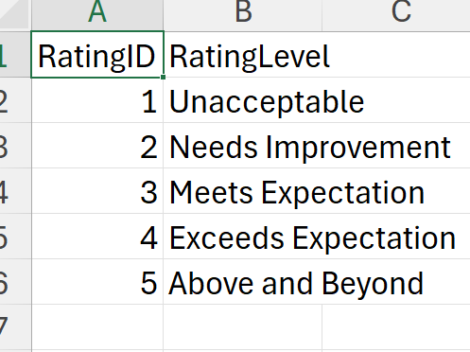
Data OverView

Slide 14
Data OverView

Slide 15
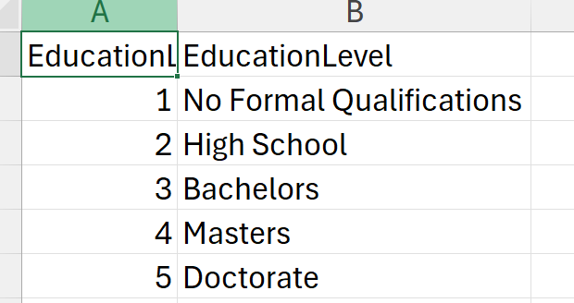
Data OverView

Slide 16
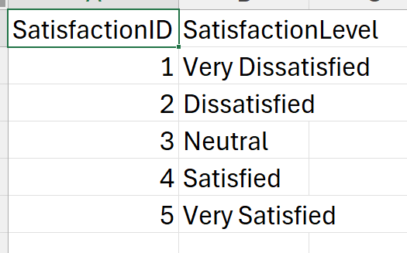
Data OverView

Slide 17

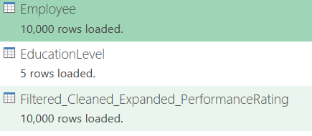

After Prompt Generation

Slide 18
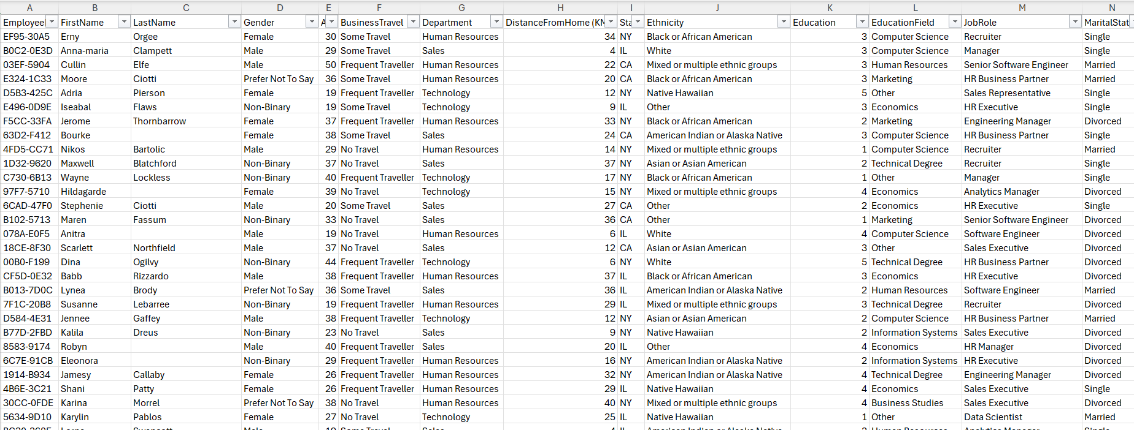
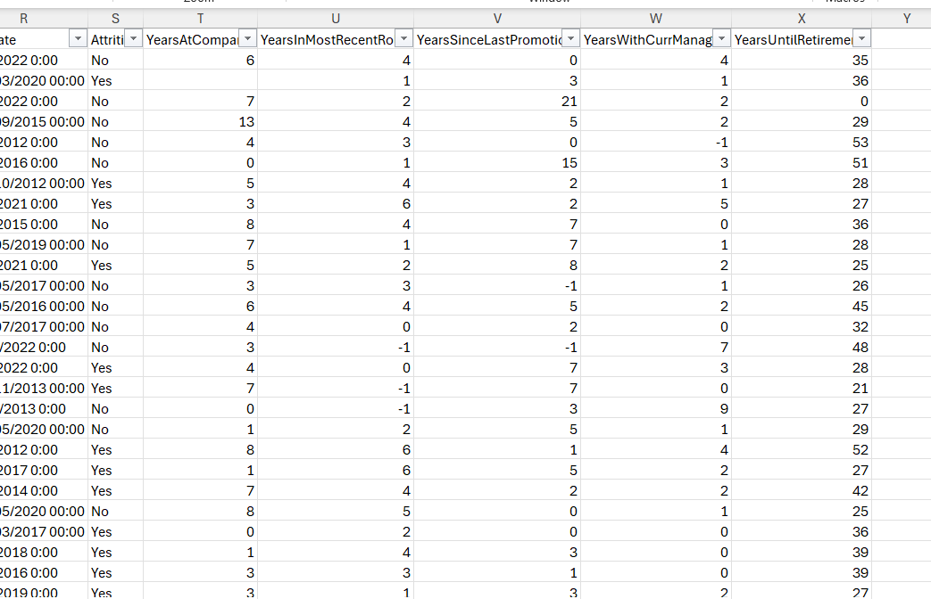
Regeneration Of Data

Slide 19
Data issues
1️⃣ Missing Values – Some fields contained empty or missing values.
2️⃣ Outliers in Salaries & Other Columns – Extreme values distorted the dataset.
3️⃣ Years at Company vs. Years with Current Manager – Some employees had more years with their manager than at the company, which was illogical.
4️⃣ Hire Date vs. Review Date Issues – Some review dates were earlier than hire dates, causing timeline inconsistencies.
6️⃣ General Data Inconsistencies – Misalignment between employee records and generated data led to inaccuracies.

Slide 20
01
02
03
Fixed Review Date Issues – Adjusted review dates to always be after hire dates
Treated Outliers – Applied upper/lower bound capping to keep values within a reasonable range
Adjusted Salary Ranges – Used the original dataset to set realistic min/max thresholds and capped extreme value
04
05
06
Calculated Attrition Rate – Derived insights by measuring employee turnover trends.
This structured approach improved data accuracy, consistency, and reliability for analysis.
Corrected Experience Mismatch – Ensured years with manager did not exceed years at the company
Aligned Employee Records – Ensured consistency across datasets for logical accuracy.
07
Handled Missing Values – Replaced using mean or median based on data distribution.
Handling issues
#

Slide 21
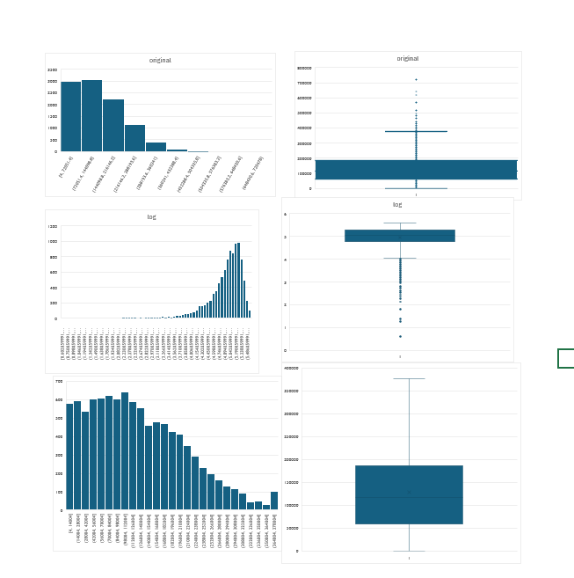
Salary

Slide 22
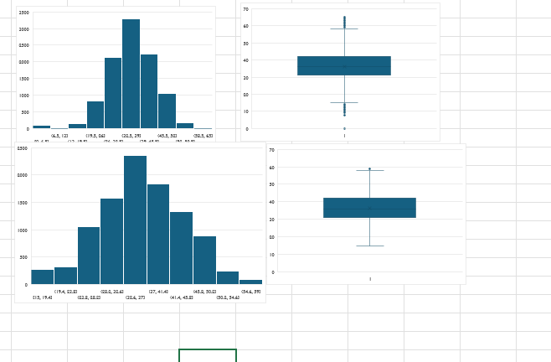
Retirement

Slide 23
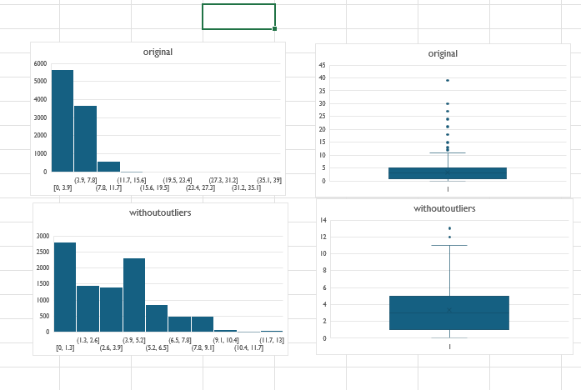
Promotion

Slide 24
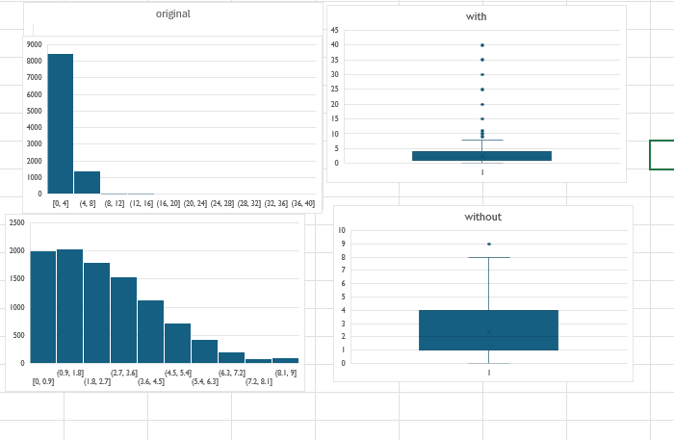
Most Recent Role

Slide 25
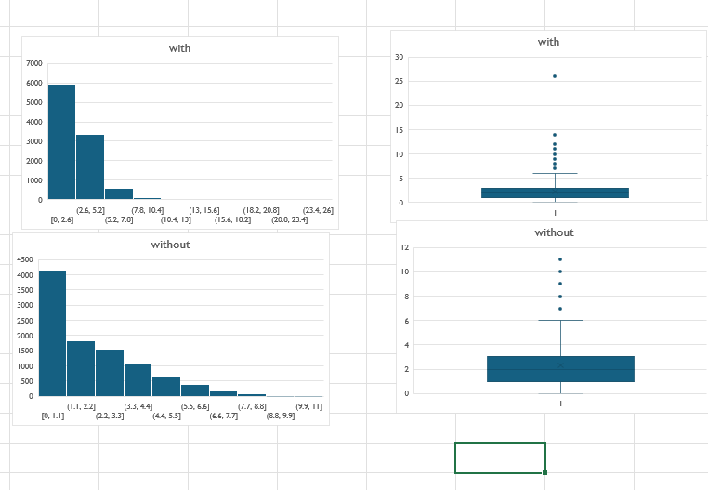
Most current Role

Slide 26
Current Manger

Slide 27
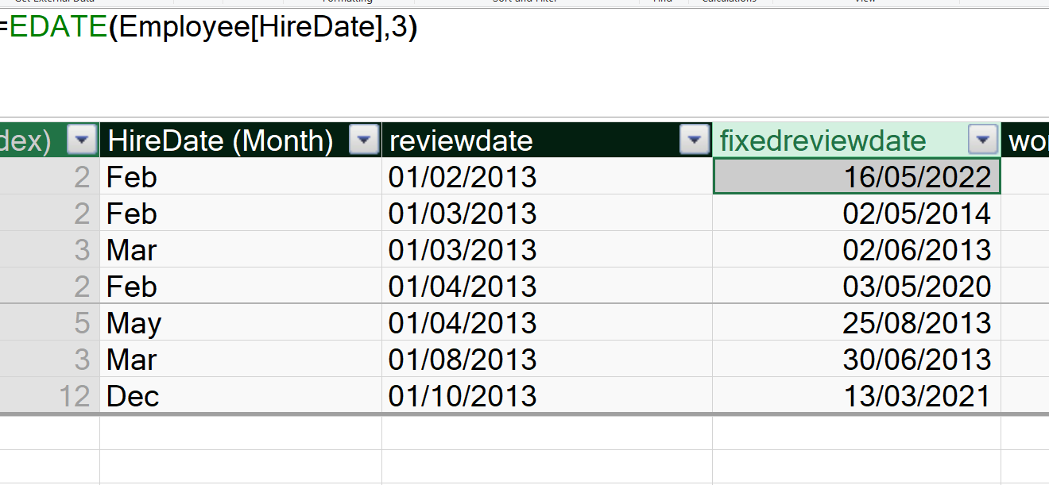
Review Date

Slide 28
AGE Capping

Slide 29
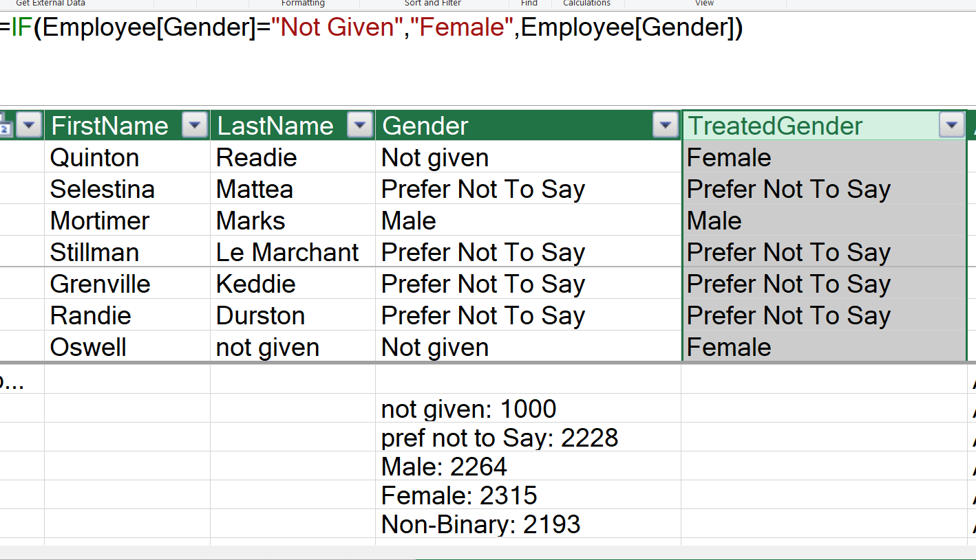
Gender

Slide 30
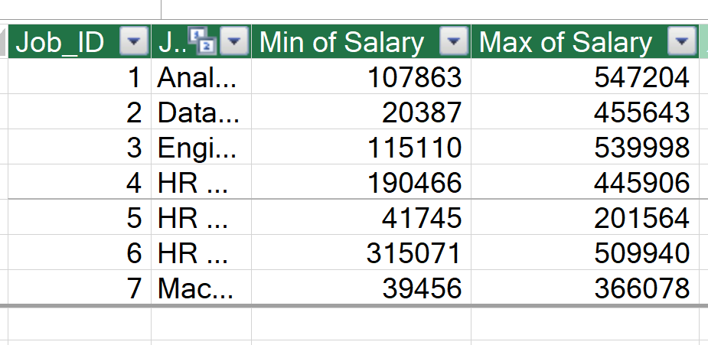
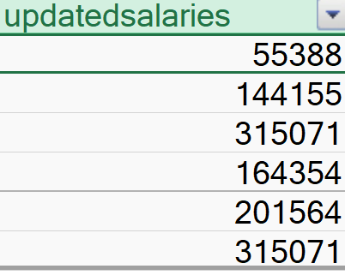
Salary

Slide 31
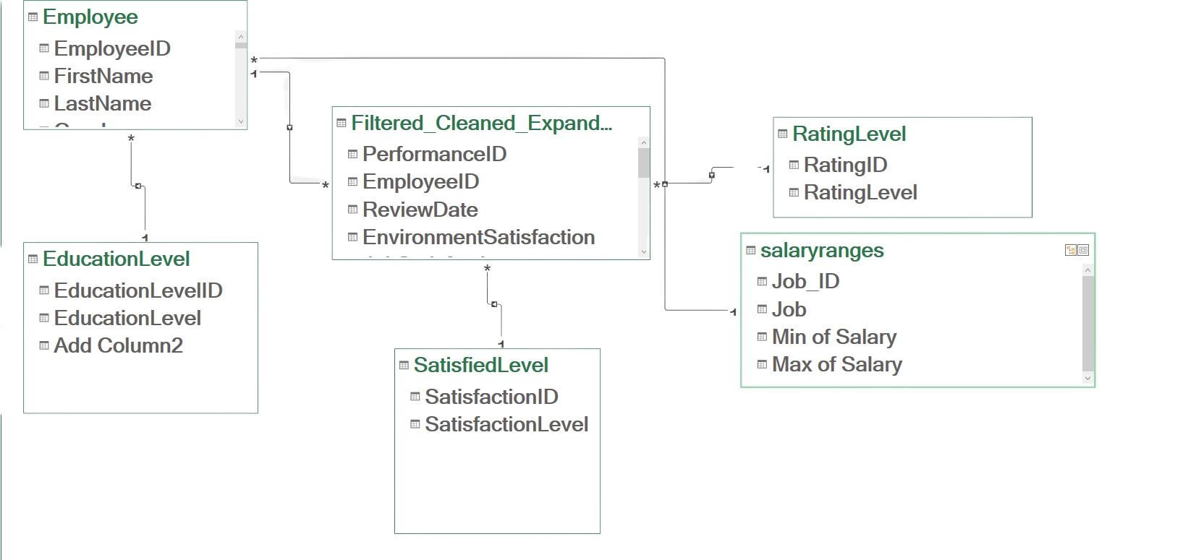
Data Model

Slide 32
EDA
What is the distribution of active vs inactive employee
Where do the highest and lowest salaries appear across job roles
What is the level of job satisfaction across roles?
Where are salary differences more noticeable across job roles?
How does attrition vary across different education fields?I
is there a particular age group that shows higher attrition rates
Are employees with advanced degrees (Masters/PhDs) more likely to stay or leave?
is there a correlation between years at the company and likelihood of attrition?

Slide 33
Excel Dashboard

Slide 34
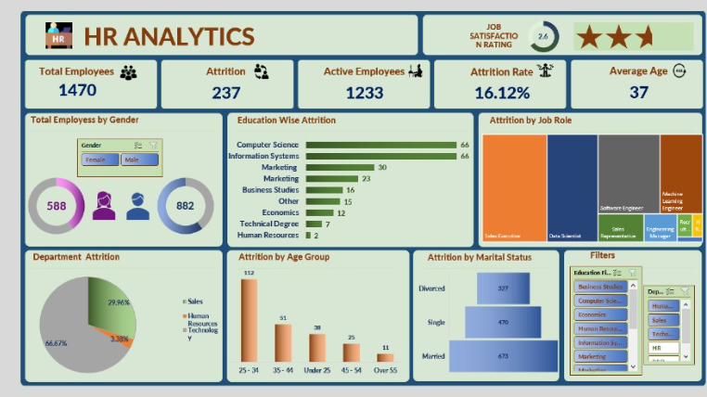

Slide 35
PowerBi Dashboard

Slide 36
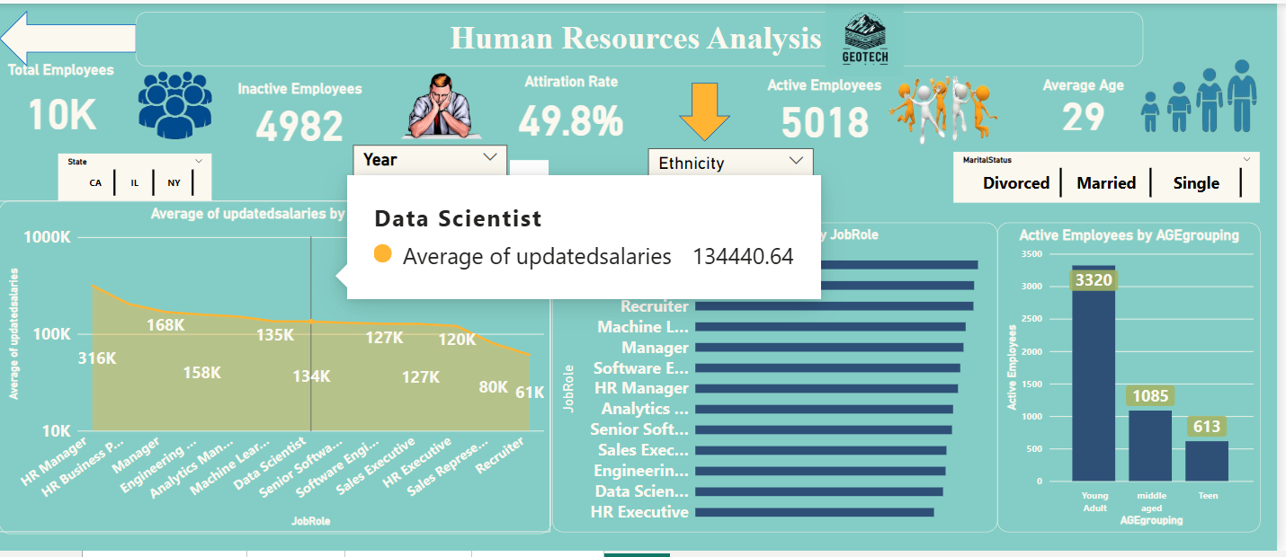

Slide 37
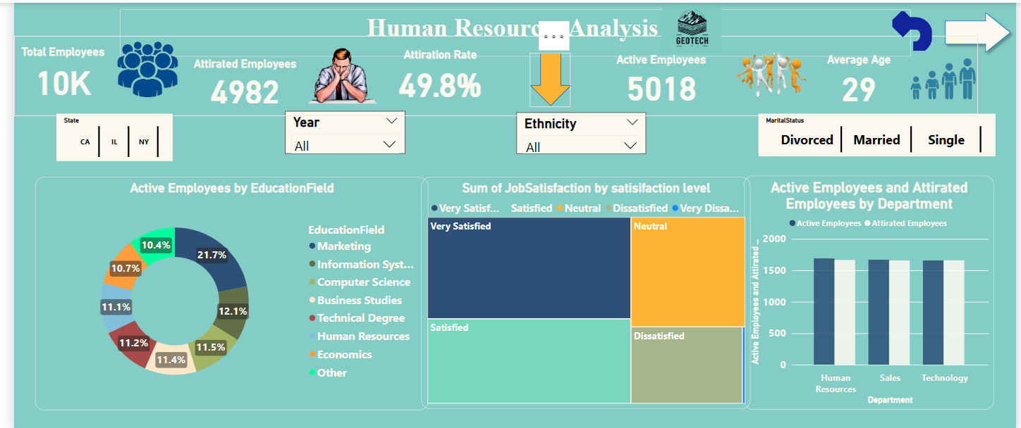

Slide 38
Recommendations
Address Salary & Compensation Gaps
Ensure all employees receive performance-based bonuses or stock options to enhance job satisfaction.
Adjust salary structures based on performance trends and industry benchmarks to maintain competitiveness.
Identify salary outliers and rectify inconsistencies in pay distribution.
Strengthen Data Collection & Validation
Ensure consistent data entry to prevent missing values in crucial fields like promotions, tenure, and manager records.
Implement automated data validation rules at the point of collection to reduce errors.
Conduct regular audits to ensure historical data remains complete and accurate.

Slide 39

Thank You

